Slide 1
Leg Extension
https://www.verywellfit.com/leg-extensions-benefit-or-risk-3498573

Slide 2
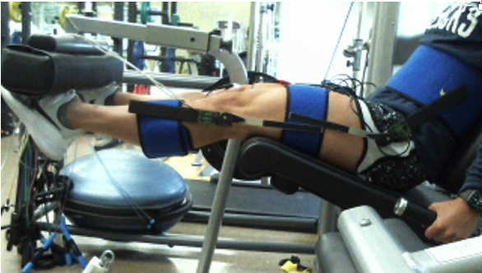
When you press up on the padded bar, it presses down on you
Limb system: lower leg/foot
Joint: knee
1 pt.
Drag the dot representing the knee joint.
Person is not moving at this moment – so torques must balance
1 pt.
Drag the vector representing the force of the bar on the top of the person’s foot
Drag lever arm
1 pt.
r⊥
Drag to indicate torque rotation direction of the barf orce
1 pt.
flexion
extension

Slide 3
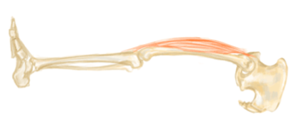
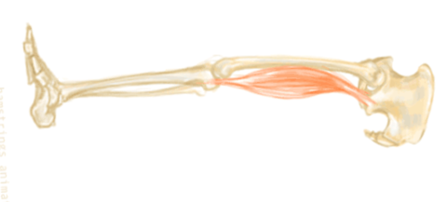
Limb system: lower leg
Joint: knee
Drag dots to show where knee joint is
2 pts.
Drag vectors to indicate muscle force placement and direction
2 pts.
Drag to show torque rotation direction of each muscle force
2 pts.
quadriceps
extension
Flexion
hamstrings
What muscle can exert a counter torque to the bar force on the lower leg around the knee?
hamstrings
2 pts.
quadriceps

Slide 4
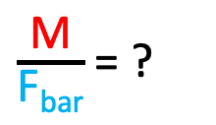
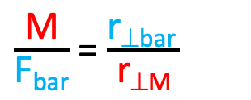
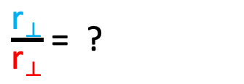
Limb system: lower leg
Joint: knee
1 pt.
Re-drag the dot representing the knee joint.
Re-drag the vectors representing the bar force and the muscle fprce
2 pts.
Re-drag lever arms for each force
2 pts.
r⊥
r⊥
Estimate ratio of lever arms
$\frac{\text{r}\text{⟂}}{\text{r}\text{⟂}}$ = ?
4 pts.
Torque Equilibrium condition
Στ = 0
τ_{muscle =} τ_{bar}
How much larger is the muscle force compared to the bar force Look at the ratio
$\frac{\text{M}}{\text{F}\text{bar}}$ = ?
4 pts.
M r_{⊥M} = F_{bar} r_{⊥bar}
$\frac{\text{M}}{\text{F}\text{bar}}$ = $\frac{\text{r}\text{⊥}\text{bar} }{\text{r}\text{⊥}\text{M}}$
Resize force vectors to show relative values
2 pts.

Slide 5
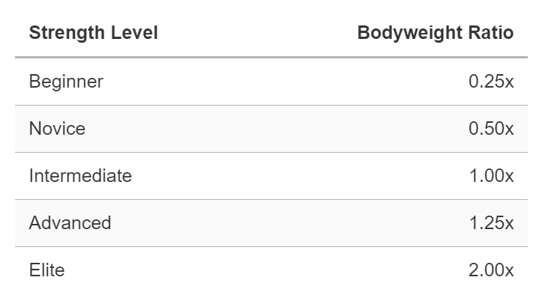

Female Leg Extension Standards
What would her (quadricep or hamstring) muscle force be, in terms of body weight?
Indicate which muscle
M = ? F_{bar}
M = ? w_{body}
4 pts.
Hint: Use the same arm lever arm ratio as before. That ratio wouldn’t change
$\frac{\text{M}}{\text{F}\text{bar}}$ = $\frac{\text{r}\text{⊥}\text{bar} }{\text{r}\text{⊥}\text{M}}$
https://strengthlevel.com/strength-standards/leg-extension/lb
Outline to choose the level and corresponding bodyweight ratio that the person can push up against
1 pt.
The force on the bar on one leg is half of that
F_{bar on one leg}= ? W_{body}
1 pt.

